Slide 1
Semeion Data Classifier
Submitted By
Nikhil Bhardwaj
CSE-2(Morning),3rd Year,
Serial No.-06515002718

Slide 2
Need for Digit Recognizer
Handwritten character recognition is one of the practically important issues in pattern recognition applications. The applications of digit recognition includes in postal mail sorting, bank check processing, form data entry, etc. The heart of the problem lies within the ability to develop an efficient algorithm that can recognize hand written digits and which is submitted by users by the way of a scanner, tablet, and other digital devices.

Slide 3
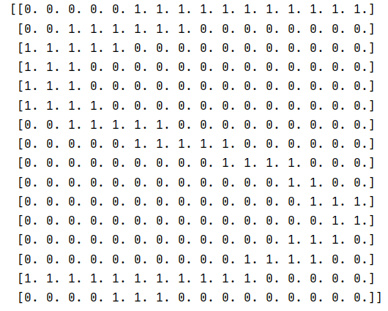
Dataset Used
The dataset is similar to MNIST handwritten digit dataset present on Kaggle. The numbers are supplied as a matrix in which each entry represents the intensity value at each point(0 - 255). The intensity values are normalised , therefore each value is either 0 or 1.The picture shown is an example of the number 5 in the dataset.

Slide 4
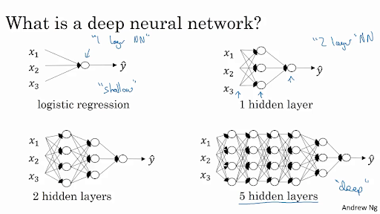
Working of neural networks
Each and every neuron is fully connected to all neurons present in previous and next layer .
The calculated values of a neuron act as input for the next layer of the neural network.
Each and every neuron has a weight and bias associated with it, which is updated in each batch of backpropagation.
Each and every neuron has a characteristic activation function associated with it.

Slide 5
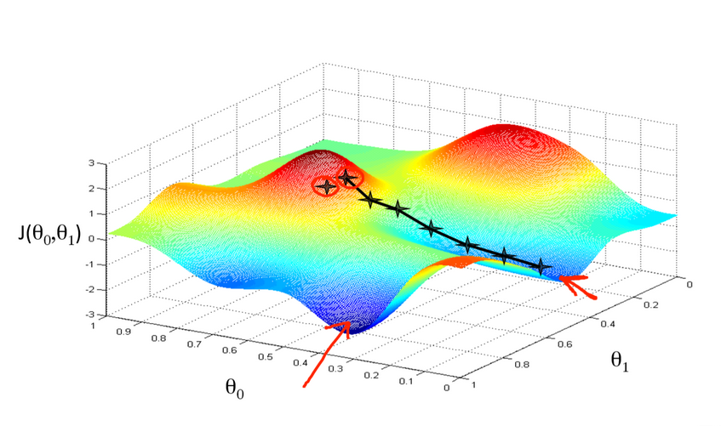
Need of Gradient Descent and meaning of loss

Slide 6
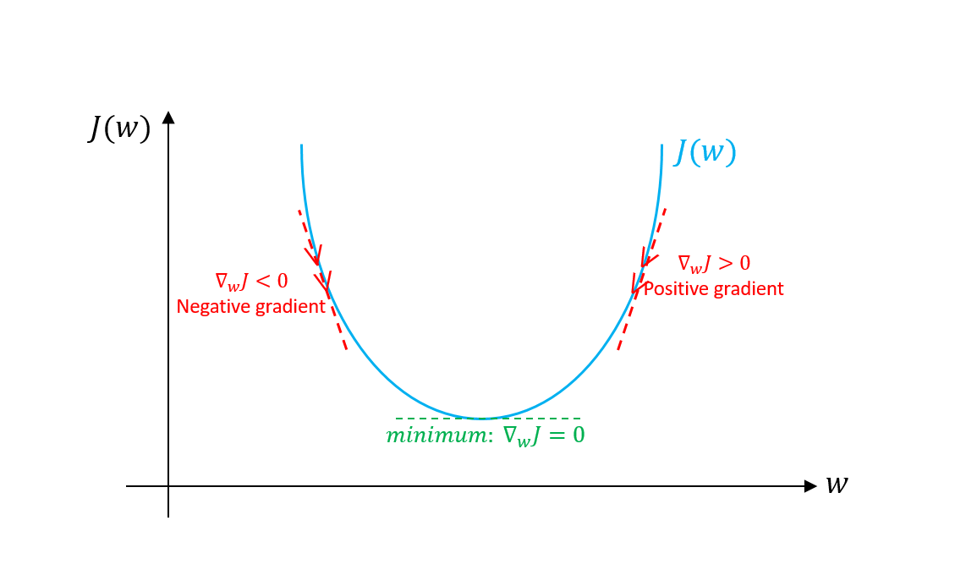
Need of convex loss function
We need a function with only one global minima.
When gradient is positive we reduce the weights, when they’re negative we increase the weights

Slide 7
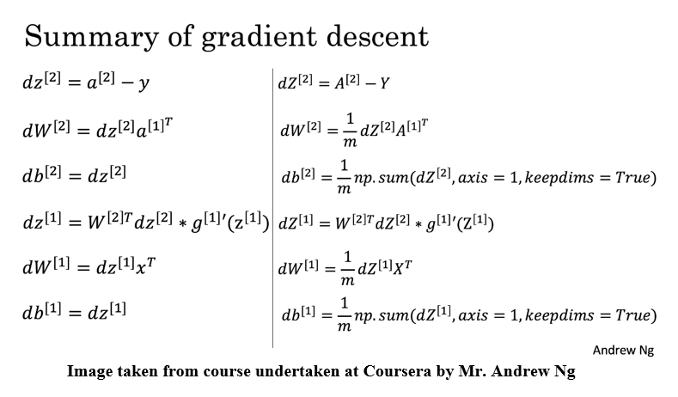

Slide 8
Libraries Used
Pandas for reading the input dataset
NumPy for efficient matrix multiplication
Matplotlib for displaying the efficiency of neural network.
TensorFlow for validation of created neural network

Slide 9
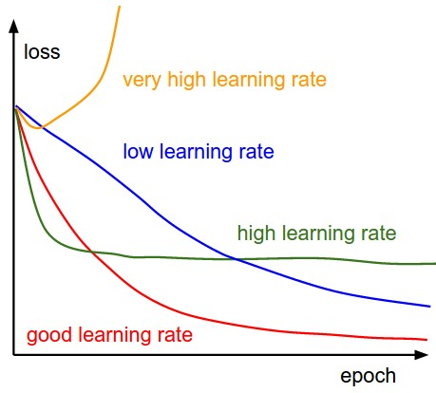
Choice of Hyperparameters
For a given neural network characteristics, the learning rate plays an important role.
A large learning rate might lead to overfitting, whereas a low learning rate leads to underfitting.
We always try to find a learning rate so that that we are able to generalize well over the given dataset.

Slide 10
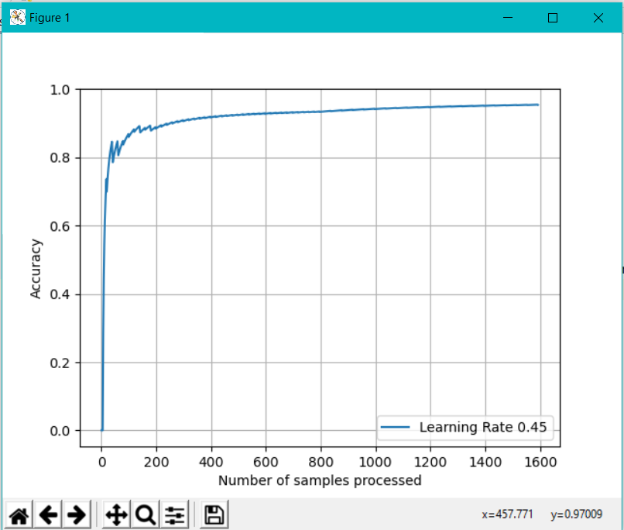
Results
The neural network made in project had [100,16,10] neurons in 3 layers.
The optimum learning rate was nearly 0.5 which confirms with the learning rate of the most optimum model on Kaggle.
The results also confirm with the results on compiling a similar model on TensorFlow.
Number of data samples was 1592 which were uniformly distributed between 0-9.

Slide 11

Uses of project
Validating the identity of incoming car.
Detection of postal code on post cards(currently being used in US Postal Service)
Automation of process where manpower is needed for reading or identifying numbers.

Slide 12
Conclusion
The main problem with neural networks is that they are computationally expensive and cannot be relied upon on real time applications where the focus is on latency.
Prone to errors as a model is never universal and needs to be trained before deployment and thus requires large amount of data before any benefit can be reaped.
Data acquisition is becoming more and more challenging due to increased awareness towards privacy.

Slide 13
References
Deeplearning.ai
Wikipedia.org
towardsdatascience.com
Google Colab(for providing virtual environment)

Slide 14
Thank You

